Slide 1
Causation vs. Correlation
By: Sean Graham

Slide 2
Question
In linear regression, independent variables can have a strong or weak impact on the dependent variables, and the two can share a strong or weak correlation.
Are these two ideas related?

Slide 3
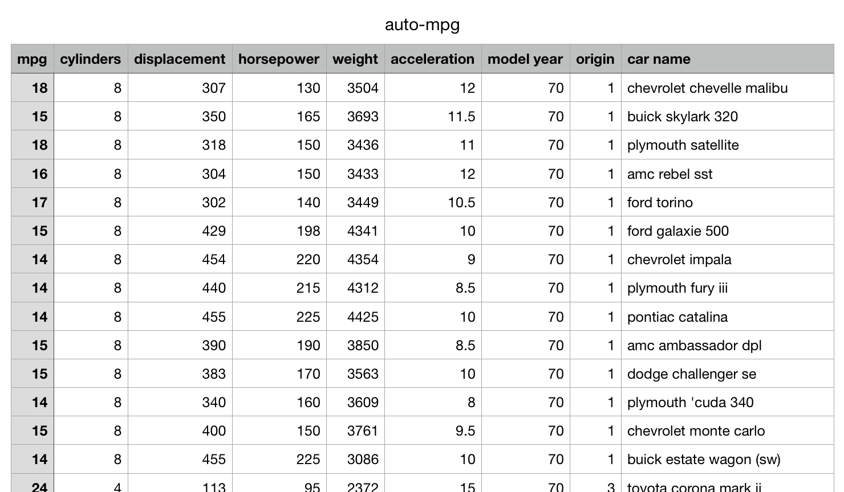
Gathering Data
I searched Kaggle for data sets.
The data had to be primarily numerical, mostly complete, and of reasonable size.
Found a set: “auto-mpg.”
Shows mpg, number of cylinders, etc. for various car models.

Slide 4
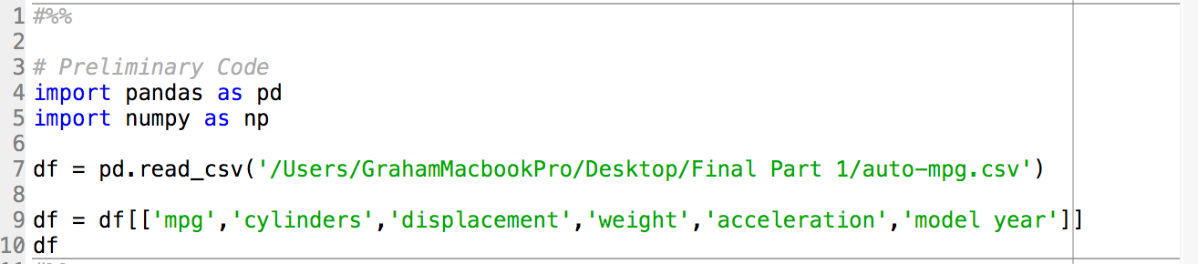
Method of Analysis: Preliminary
I made “mpg” the dependent variable.
I made “number of cylinders,” “displacement,” “weight”, “acceleration”, and “model year” the independent variables.
I removed excess columns and imported the data into Spyder.

Slide 5
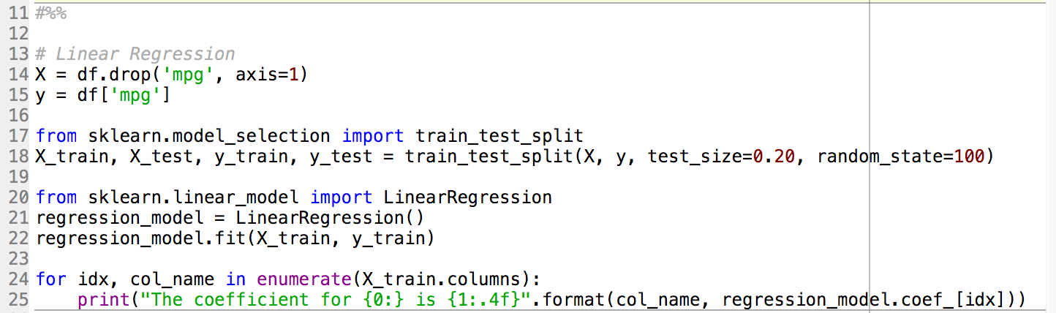
Method of Analysis: Linear Regression
I created a linear regression model to find what affected mpg the most.

Slide 6
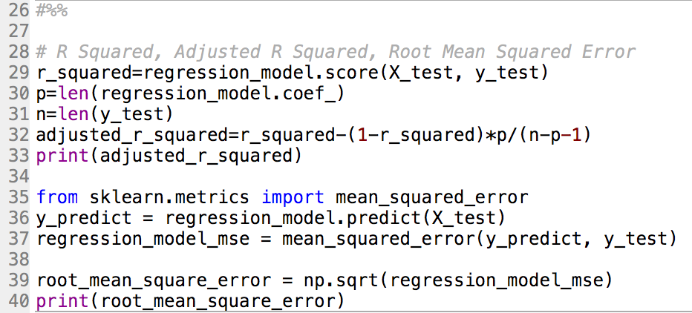
Method of Analysis: adjusted R^2 and RMSE
I found the adjusted r squared and root mean squared error to test the accuracy of the regression model.

Slide 7
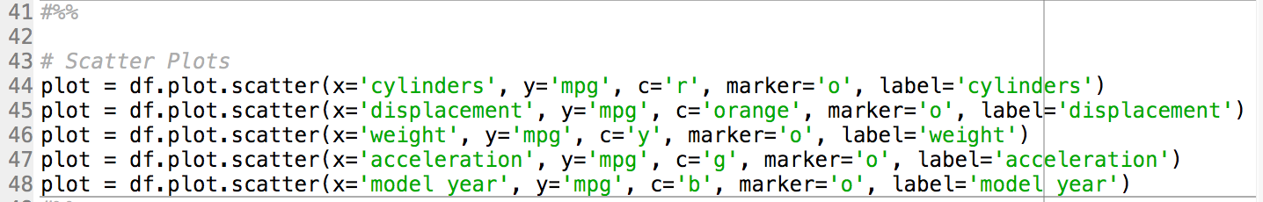
Method of analysis: Scatter Plots
I created five scatter plots.
The x-axes were the five independent variables.
The y-axes for each were ”mpg.”
This gave an idea of correlation over all values and showed any outliers.

Slide 8
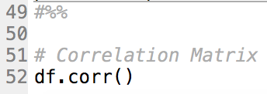
Method of Analysis: Correlation coefficient Matrix
I created a correlation coefficient matrix.
It gave a more precise yet less informative idea of correlation.

Slide 9
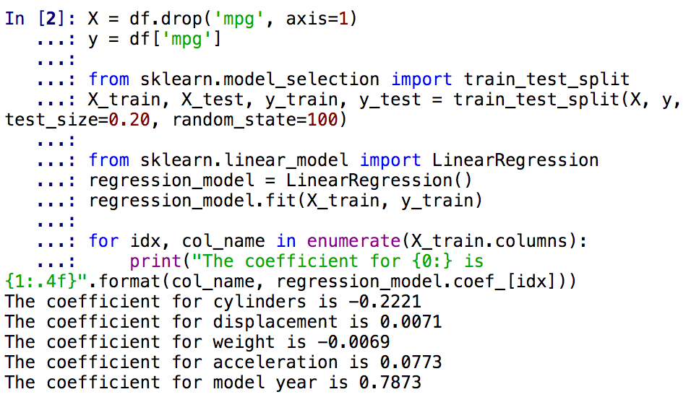
Results: Linear Regression
In the linear regression, model year affects mpg most, number of cylinders is second, and other variables are negligible.

Slide 10
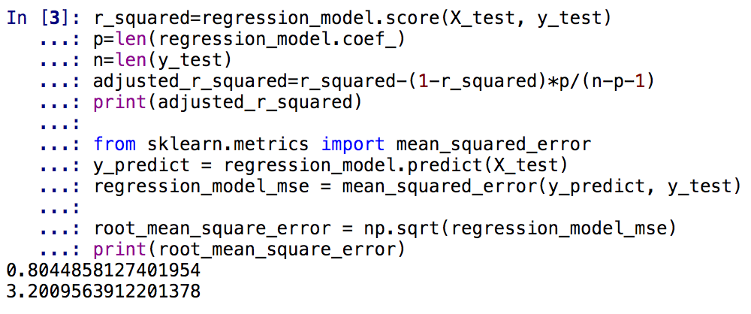
Results: adjusted R^2 and RMSE
Adjusted R squared was about 0.8, and the root mean squared error was about 3.2.

Slide 11
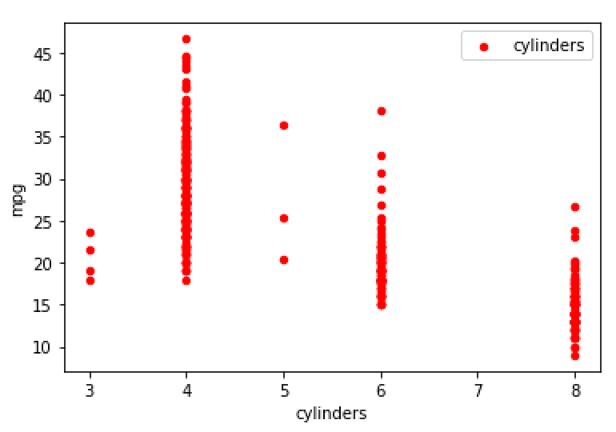
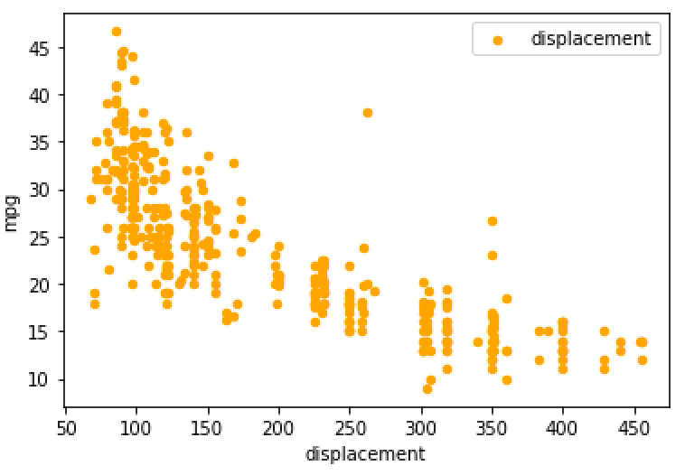
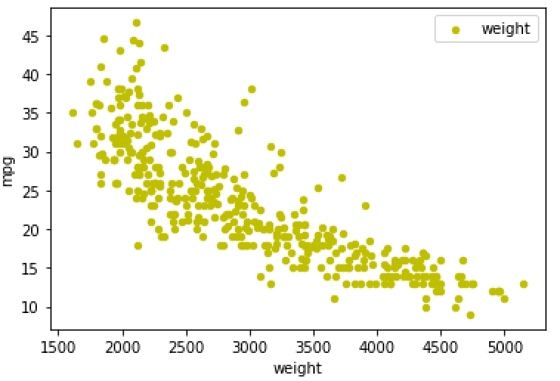
Results: Scatter Plots and Correlation Coefficient Matrix
The scatter plots and correlation coefficient matrix showed that “cylinders,” “displacement,” and “weight,” had strong, negative correlations with mpg,

Slide 12
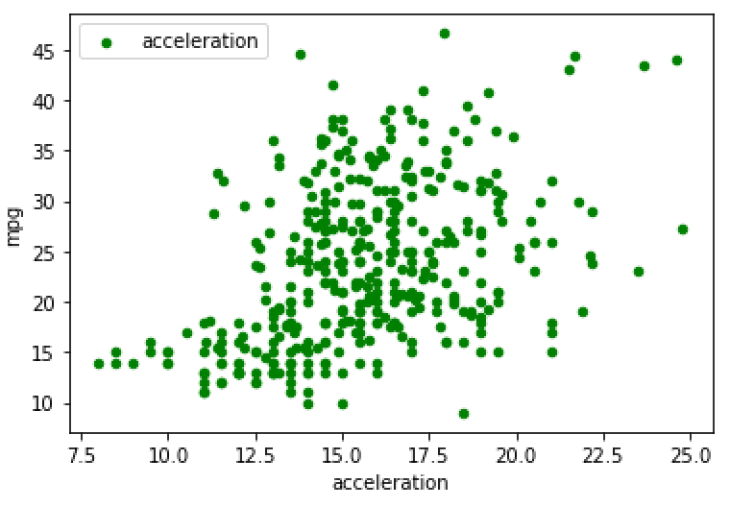
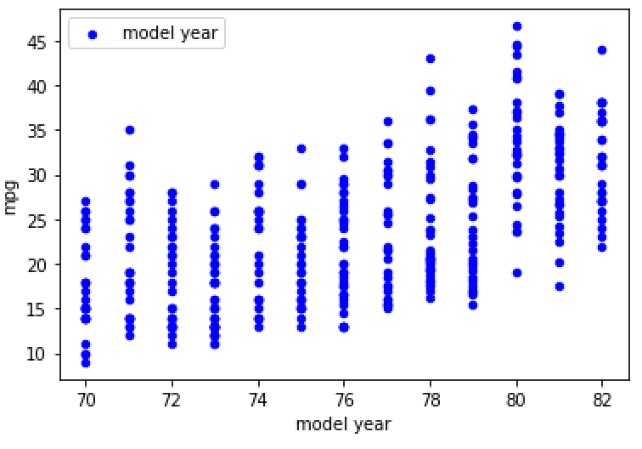
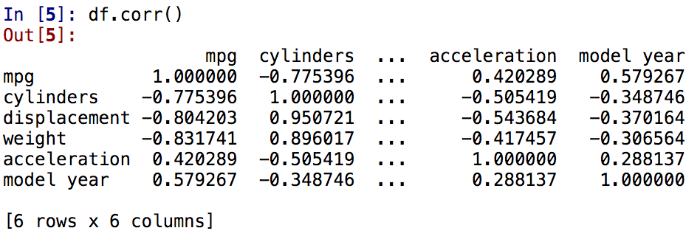
Results: Scatter Plots and Correlation Coefficient Matrix
while “acceleration,” and “model year” had weak, positive correlations with mpg.

Slide 13
Conclusions
What affects mpg isn’t related to what correlates with it.
The slopes of the trendlines on the scatterplots seem to determine what impacts the linear regression model.
For slope, consider the axes scales.
In short, correlation doesn’t affect the linear regression model; it’s the trendlines.

Slide 14
Thanks for Listening

